Slide 1
Welcome

Slide 2
Presented By:
Ahmad Subaktagin Jabir
ID#16-02-04-061
Md. Zahid Fesabelilla
ID#16-02-04-082

Slide 3

Snake Game

Slide 4
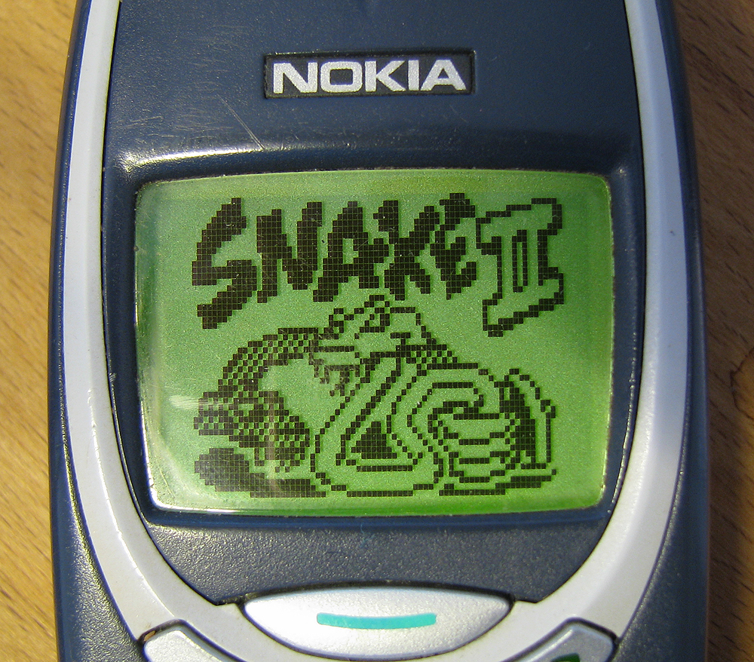



Slide 5

Menu
Play Game
High Scores
Exit

Slide 6
INSTRUCTION
How to Move up
How to Move down
How to Move left
How to Move right
How to eat fruit

Slide 7
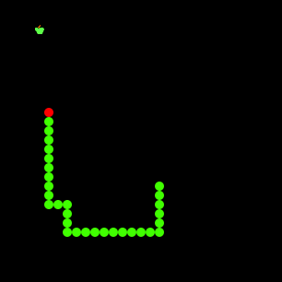
How to Capture fruit

Slide 8
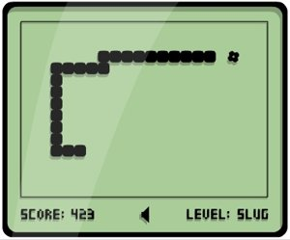
Scoring Point

Slide 9
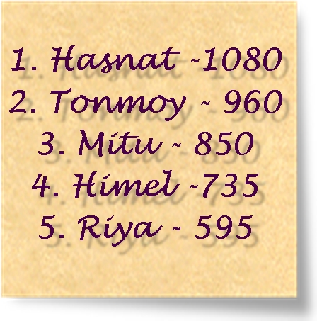
High Scores

Slide 10
Upcoming Features
Color changing feature
More feature for Game Over
Bonus Score for Capturing big fruit

Slide 11
ANY QUESTIONS????

Slide 12

THANK YOU VERY MUCH FOR WATCHING

